Slide 1
online education: Course difficulty Impact
Surendar N. Reddy
DeVos Graduate School, Northwood University
MTH 650: Introduction to Data Analytics
Dr. Itauma Itauma
March 9th, 2025

Slide 2
Introduction
- Online education is rapidly growing.
- Course ratings influence enrollment and retention.
- Study examines impact of course difficulty and certificate type on student ratings.
- Findings help improve course design and student satisfaction.

Slide 3
Problem Statement
This study aims to analyze how course difficulty and certification type impact student ratings in online education. Understanding these relationships can help institutions refine their courses to improve student satisfaction and engagement.

Slide 4
Literature Review
• Online education has transformed learning accessibility and flexibility.
• Course ratings play a vital role in student decision-making and course selection.
• Prior research indicates that course difficulty impacts student engagement and completion rates.
• Certification type influences perceived course value and employability outcomes.
• Studies suggest that personalized learning paths and interactive content improve student satisfaction.

Slide 5
Dataset Description & Research Steps
1. Data Collection: Gathered course ratings, difficulty levels, and certificate types.
2. Data Cleaning: Checked for accuracy, removed missing values and outliers.
3. Exploratory Data Analysis (EDA): Used histograms, boxplots, and statistics.
4. Identified trends in student ratings.
5. Derived insights and recommendations.

Slide 6
Data Analysis - Key Insights
- Beginner and Mixed courses have the highest ratings, while Advanced courses show variation.
- 'COURSE' has the highest rating, while 'SPECIALIZATION' has the lowest.
- Boxplots show 'COURSE' has more outliers, indicating varied student experiences.

Slide 7
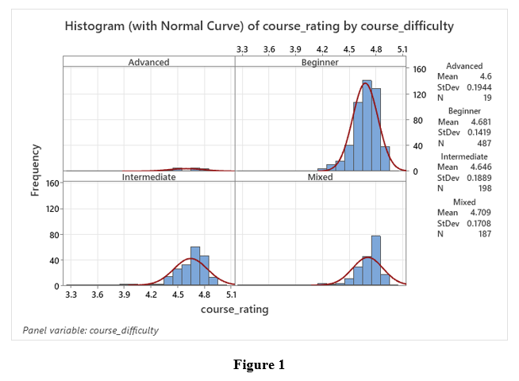
Data Analysis - Course Difficulty Impact

Slide 8
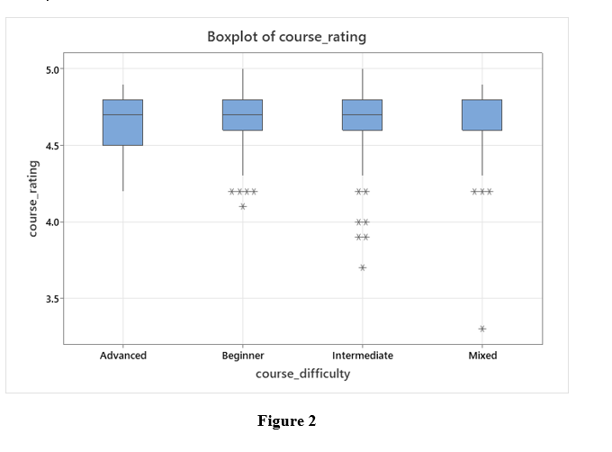
Boxplot of Course Ratings by Difficulty

Slide 9
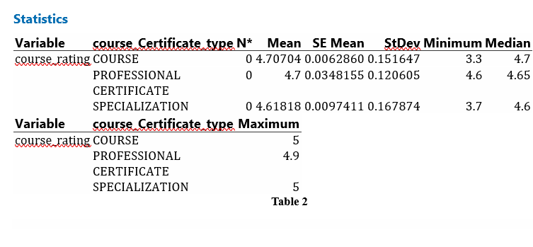
Data Analysis - Certificate Type Impact

Slide 10
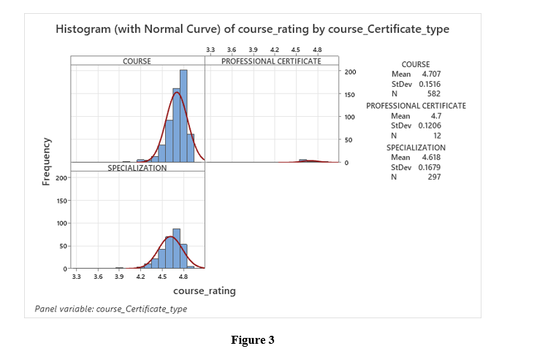
Boxplot of Course Ratings by Certificate Type

Slide 11
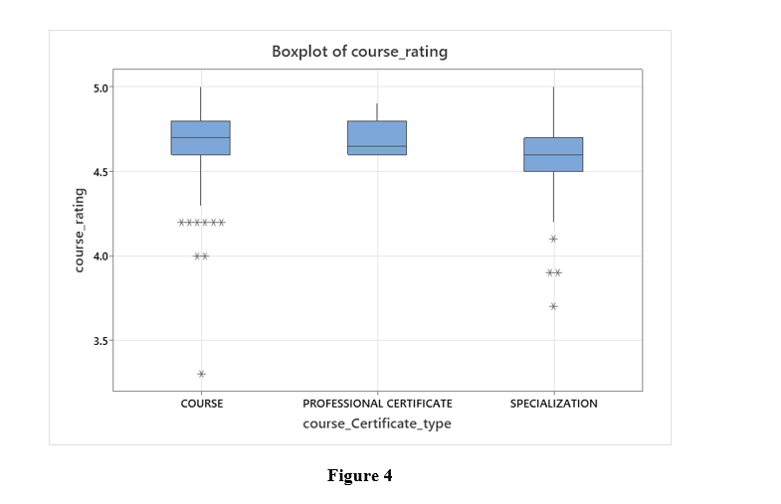
Statistical Summary of Course Ratings

Slide 12
Findings
- Easier courses (Beginner, Mixed) receive higher ratings.
- 'COURSE' and 'PROFESSIONAL CERTIFICATE' rated higher than 'SPECIALIZATION'.
- Advanced courses show greater variability in ratings.

Slide 13
Recommendations
📌 **For Course Difficulty:**
- Design Advanced courses with clearer learning paths and better support materials.
- Offer structured learning assistance (e.g., mentorship, discussion forums).
📌 **For Certificate Type:**
- Emphasize the career value of Specialization courses.
- Make Specialization courses more engaging with hands-on projects and industry collaboration.

Slide 14
Conclusion
🚀 These findings reveal that students favor courses that balance accessibility with career value.
- To enhance student satisfaction, institutions should ensure that challenging courses provide adequate support.
- Certifications should align with professional expectations.
- By leveraging these insights, online education platforms can improve course completion rates and overall learning experiences.

Slide 15
Thank You!
By Surendar Reddy

